Slide 1
Software Quality Assurance and Testing Technology
1st Semester, Fall 2022
Xiaoping CHE (xpche@bjtu.edu.cn)
Associate Professor
School of Software Engineering
Beijing Jiaotong University

Slide 2





Rules

Slide 3
Rules
Project 20%
Assignments 40%
Final Exam 40%

Slide 4
How
16 Weeks Plan
Week 1: The basic concepts and theories of testing
Week 2-3: Principles of Testing
Week 4-5: Test Cases & Black Box Testing
Week 6-7: White Box Testing
Week 8: Usability Testing
Week 9: Mutation Testing
Week 10: Finite Automata & BNF

Slide 5

How
References
Ron Patton, Software Testing (2th Edition)
Glenford J. Myers, The Art of Software Testing (3rd Edition)
Gerald M. Weinberg, Perfect Software

Slide 6
Mutation Testing
Topics in Testing Software
Mutation Testing

Slide 7
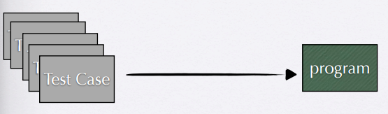
Mutation Testing
How good these test cases are?
Coverage testing !

Slide 8
Mutation Testing
Problem with coverage criteria
Coverage is equal or can no more improved
100% code is covered with statement coverage
Code testability, dynamic runtime dependency injection
Coverage misses an important aspect: the oracle problem

Slide 9
Mutation Testing
Test oracles
Executing all the code is not enough
We need to check the behavior of the system under test
Does this thing actually do what we want?
Test oracles are the judge
Automated oracles can be spec, model
Or manual oracles have to be defined

Slide 10
Mutation Testing
How good are my tests?
Coverage = how much of the code is executed
But how much of the code is checked?
We never know if a program is bug-free and where the bugs are
“Testing shows the presence, not the absence of bugs” Edsger W. Dijkstra
Testing mindset: find bugs
not to prove correctness, because testers tend to produce tests that pass

Slide 11
Mutation Testing
Mutation testing
Key idea: Learning from earlier and popular mistakes to prevent them from happening again
etc. typing mistake, copy/paste, errors
Key technique: Simulate earlier mistakes and see whether the resulting defects are found
Called as fault-based testing or mutation testing

Slide 12

Mutation Testing
Mutation testing
Analogy: catching fish with a net
release some masked fishes into a lake
can the net catch them all back?

Slide 13
Mutation Testing
Mutation testing terms
Mutant: a copy of the original program with a small change (seeded fault)
Mutation operator: applied to make change (automatically) to the original program
Mutant killed: if its behaviors/outputs differ from those of the original program
Mutant score: of a test case = number of killed mutants / total number of mutants

Slide 14
Mutation Testing
Mutation operators
Syntactic changes
Arithmetic operator, e.g. “-” -> “+”
Relational operator, e.g. “ > ” -> “ < ”
Conditional operator, e.g. “ && ” -> “ || ”
OO Operator
Encapsulation
Inheritance
Polymorphism

Slide 15
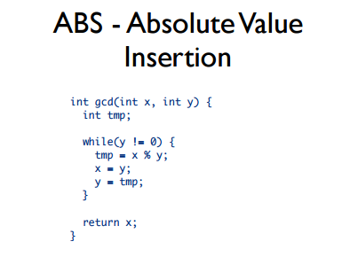
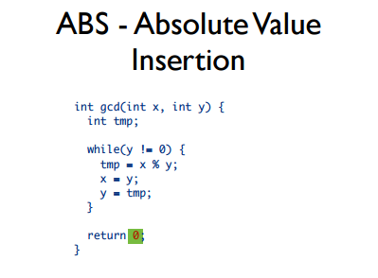
Mutation Testing
ABS operator

Slide 16
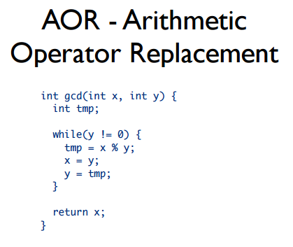
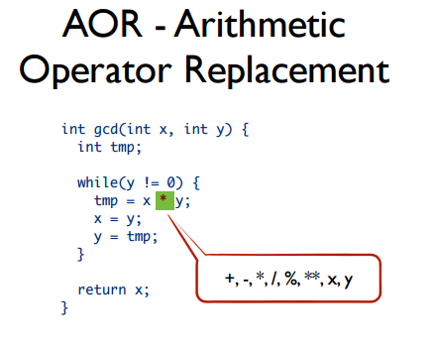
Mutation Testing
AOR - Arithmetic Operator Replacement

Slide 17
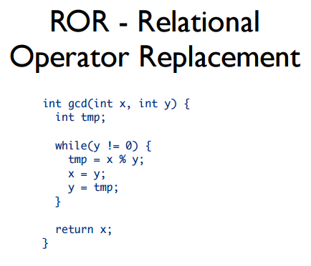
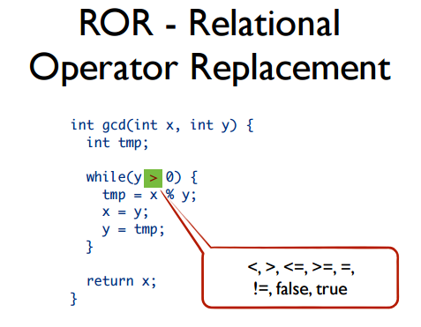
Mutation Testing
ROR - Relational Operator Replacement

Slide 18
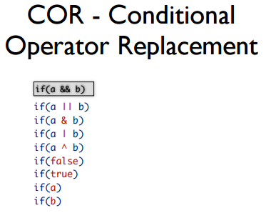
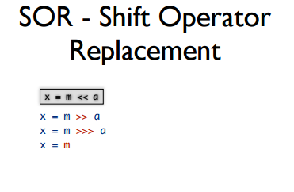
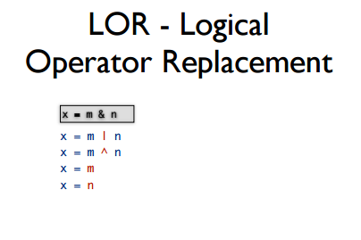
Mutation Testing
Mutation operators

Slide 19
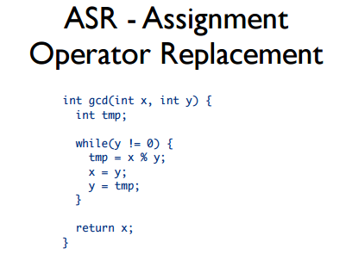
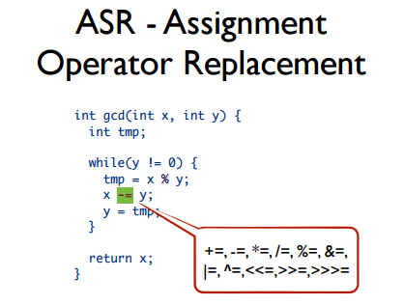
Mutation Testing
Mutation operators

Slide 20
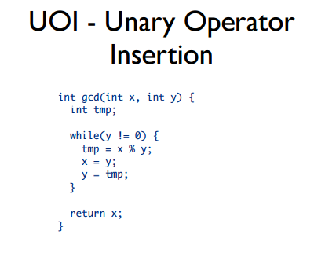
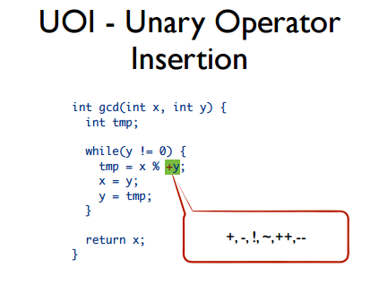
Mutation Testing
Mutation operators

Slide 21
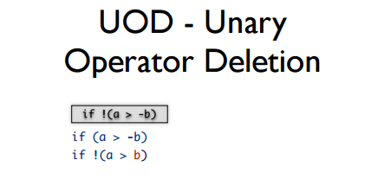
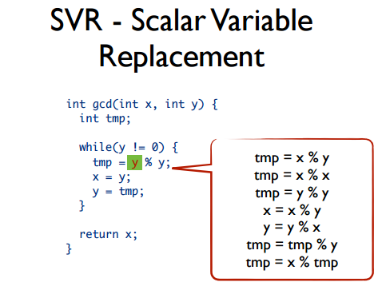
Mutation Testing
Mutation operators

Slide 22
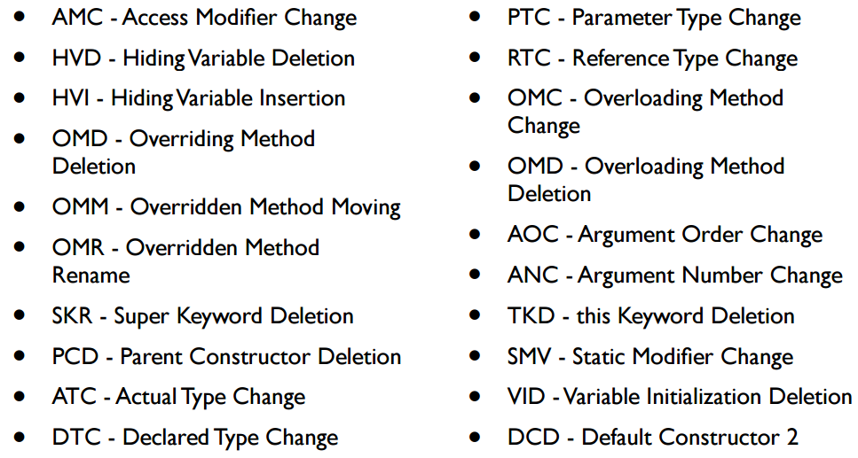
Mutation Testing
OO Mutation operators

Slide 23
Mutation Testing
OO Interface mutation operators
Integration testing
Change calling method by modifying the values that are sent to a called method
Change a calling method by modifying the call
Change a called method by modifying the values that enter/leave the method
Change a called method by modifying statements that return from the method

Slide 24
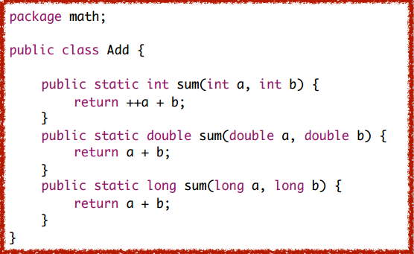
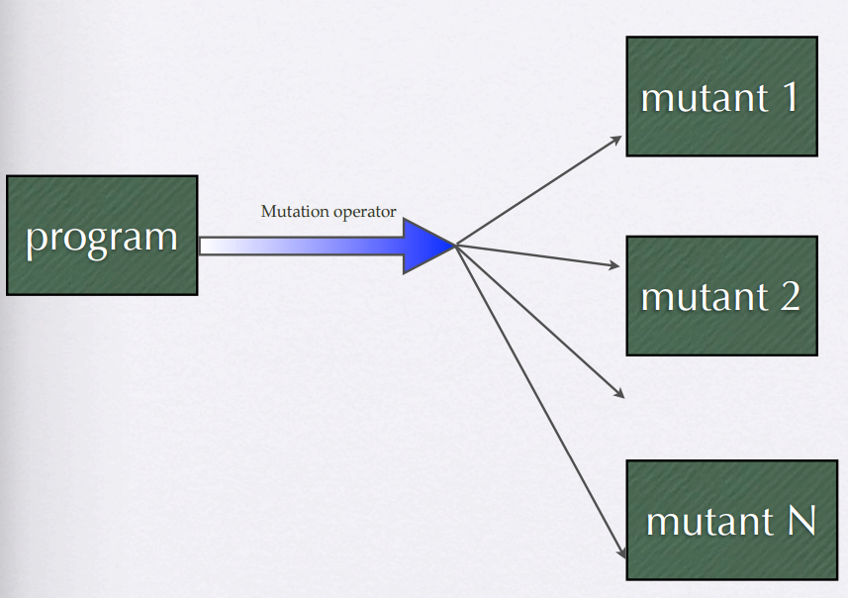
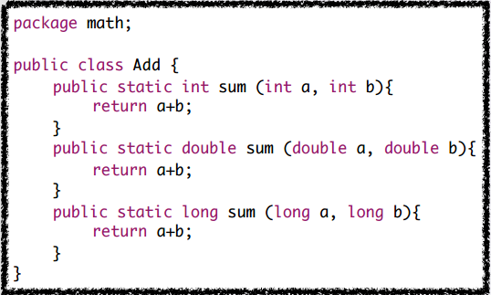
Mutant creation

Slide 25
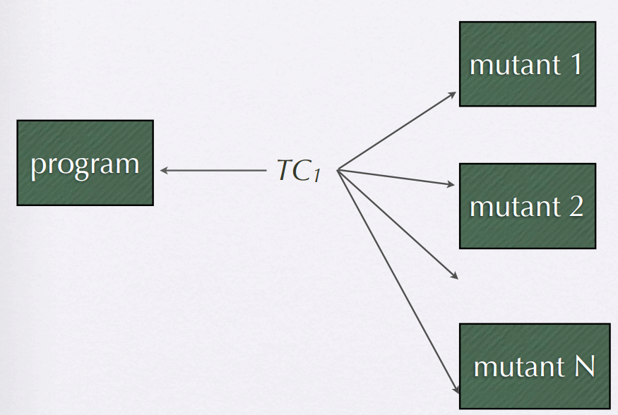


Mutant Score
Mutant score(TC1)
= killed mutants/ N

Slide 26
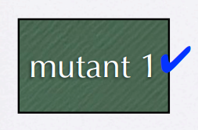
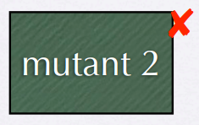
Mutation Testing
Live vs Dead mutants
Live mutant
we need to investigate more
more test cases, more oracles
is the mutant killable?
* equivalent mutants
* mutant reachability and propagation
Dead mutant - OK

Slide 27
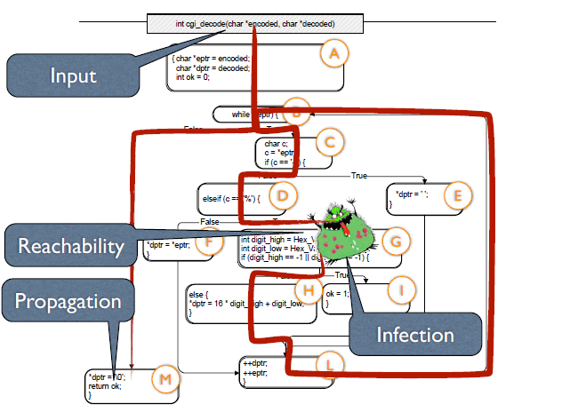
Mutation Testing

Slide 28
Mutation Testing
Equivalent mutants
Mutation = syntactic change
The change might leave the semantics unchanged
Equivalent mutants are hard to detect (undecidable problem)
Might be reached, but no infection
Might infect, but no propagation

Slide 29
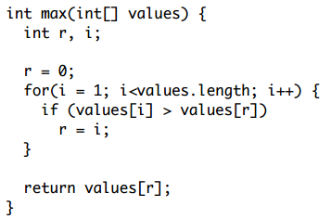
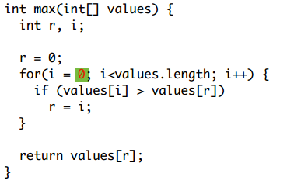
Mutation Testing
Example of equivalent mutant
Original
Mutant

Slide 30
Mutation Testing
Mutant Scores (Revised)
Equivalent mutants are discarded
Mutant score(TC1) = killed mutants/ (N -number of equivalent mutants)

Slide 31
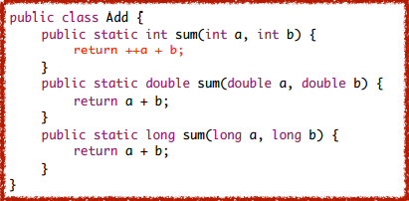
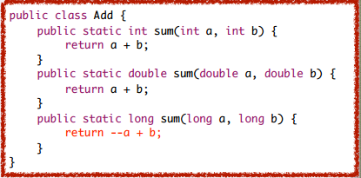
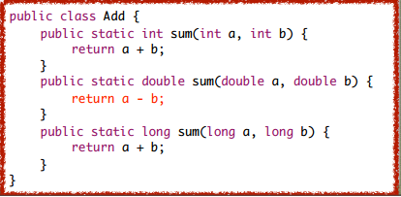
Mutant creation

Slide 32
Mutation Testing
Topics in Testing Software
Performance of Mutation Testing

Slide 33
Performance of Mutation Testing
Mutation Testing is Expensive
Many mutation operators possible
Proteum - 103 Mutation Operators for C
MuJava - Adds 24 Class level Mutation Operators
Each mutation operator results in many mutants, depending on program under test
Each mutant needs to be compiled
Each test case needs to be executed against every mutant

Slide 34
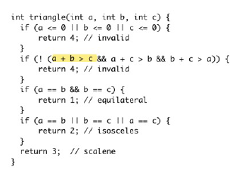
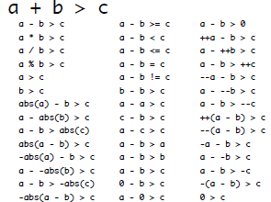
Performance of Mutation Testing
Example
Only one condition > 42 mutants

Slide 35
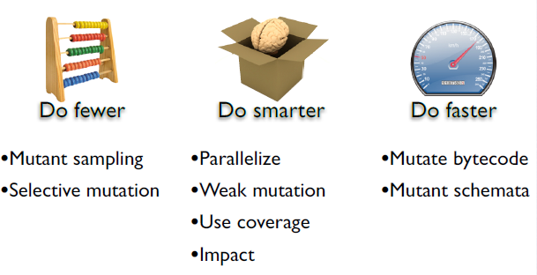
Performance of Mutation Testing
Improving Performance

Slide 36
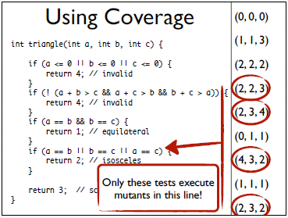
Performance of Mutation Testing
Using coverage infomation
If test cases don’t execute the changed code, no way to kill it
Select only test cases that cover the changed code.

Slide 37
Performance of Mutation Testing
Using weak mutation
Strong mutation: injected states are propagated to some observable behaviors
Requires full execution of the mutants
Weak mutation: check only if program state is injected
Inspect the internal state of the system right at the subsequence statement from the changed code
No need to fully executed the whole mutant
Reported to save 50% execution time

Slide 38
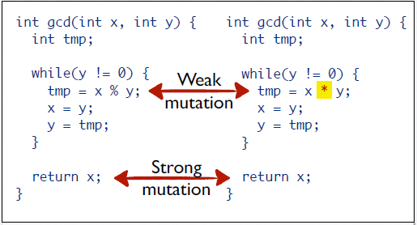
Performance of Mutation Testing
Using weak mutation

Slide 39
Finite automata
Topics in Testing Software
Finite automata

Slide 40
Finite automata (Mealy machines)
S - finite set of states. (size n)
S - set of inputs. (size d)
O - set of outputs, for each transition.
(s₀ ∈ S - initial state).
δ ⊆ S × S → S - transition relation (deterministic but sometimes not defined for each input per each state).
λ ⊆ S × S → O - output on edges.
Notation:
δ(s,a₁a₂..a_{n})= δ(… (δ(δ(s,a₁),a₂) … ),a_{n})
λ(s,a₁a₂..a_{n})= λ(s,a₁)λ(δ(s,a₁),a₂)…λ(δ(… δ(δ(s,a₁),a₂) … ),a_{n})

Slide 41
Finite automata (Mealy machines)
S - finite set of states. (size n)
S– set of inputs. (size d)
O – set of outputs, for each transition.
(s₀ ∈ S - initial state).
δ ⊆ S × S → S - transition relation.
λ ⊆ S × S →O – output on edge.
S={s₁, s₂, s₃ }, S={a, b }, O={0,1 }.
δ(s₁,a)=s₃ (also s₁=a=>s₃),
δ(s₁,b)=s₂,(also s₁=b=>s₂)…
λ(s₁,a)=0 , λ(s₁,b)=1,…
δ(s₁,ab)=s₁, λ(s₁,ab)=01
b/1
s₁
s₂
a/0
b/1
b/0
a/0
s₃
a/0

Slide 42
Why deterministic machines?
Otherwise no amount of experiments would guarantee anything.
If dependent on some parameter (e.g., temperature), we can determinize, by taking parameter as additional input.
We still can model concurrent system. It means just that the transitions are deterministic.
All kinds of equivalences are unified into language equivalence.
Also: connected machine (otherwise we may never get to the completely separate parts).

Slide 43
Determinism
a/1
b/1
a/1
When the black box is nondeterministic, we might never test some choices.

Slide 44
Preliminaries: separating sequences
A set of sequences X such that if we execute them from different states, at least one of them will give a different output sequence.
s≠t →∃µ∈X λ(s, µ )≠λ(s, µ )
b/1
s₁
s₂
a/0
b/1
b/0
a/0
s₃
a/0
Start with one block containing all states {s₁, s₂, s₃}.

Slide 45
A: separate to blocks of states with different output.
b/1
s₁
s₂
a/0
b/1
a/0
b/0
s₃
a/0
The states are separated into {s₁, s₃}, {s₂} using the string b.
But s₁ and s₃ have the same outputs to same inputs.

Slide 46
Repeat B : Separate blocks based on input that cause moving to different blocks.
b/1
s₁
s₂
If string x separated blocks B₁, B₂, and letter a splits part of block C to move to B₁ and part to B₂, then ax separates C into C₁, C₂, accordingly.
a/0
b/1
b/0
a/0
s₃
a/0
Separate first block using b to three singleton blocks obtaining separation sequence bb. Separating sequences: b, bb. Max rounds: n-1, sequences: n-1, length: n-1.

Slide 47
Want to know the state of the machine (at end): Homing sequence.
After firming homing sequence, we know in what state we are by observing outputs.
Find a sequence µ such that δ(s, µ )≠δ(t, µ ) ➔ λ(s, µ )≠λ(s, µ )
So, given an input µ that is executed from state s, we look at a table of outputs and according to a table, know in which state r we are.

Slide 48
Homing sequence
Algorithm: Put all the states in one block (initially we do not know what is the current state).
Then repeatedly separate blocks, as long as they are not singletons, as follows:
Take a non singleton block, append a distinguishing sequence µ that separates at least two states in that block.
Update each block to the states after executing µ. (Blocks may not be disjoint, its not a partition!)
Max length of sequence: (n-1)² (Lower bound: n(n-1)/2.)

Slide 49
Example (homing sequence)
b/1
{s₁, s₂, s₃}
s₁
s₂
a/0
b
1
1
0
b/1
{s₁, s₂} {s₃}
b/0
a/0
s₃
b
1
1
0
a/0
{s₁} {s₂} {s₃}
On input b and output 1, we still don’t know if we were in s₁ or s₃, i.e., if we are currently in s₂ or s₁. So separate these cases with another b.

Slide 50
Synchronizing sequence
One sequence takes the machine to the same final state, regardless of the initial state or the outputs.
That is: find a sequence µ such that for each states s, t, δ(s, µ )=δ(t, µ )
Not every machine has a synchronizing sequence.
Can be checked whether exists and if so, can be found in polynomial time.
a/0
b/1
b/0
a/0
b/1
a/1

Slide 51
Algorithm for synchronizing sequences
Construct a graph with ordered pairs of nodes (s,t) such that (s,t )=a=>(s’,t’ ) when s=a=>s’, t=a=>t’. (Ignore self loops, e.g., on (s₂,s₂).)
a/0
s₁
b/1
b/0
a/0
s₁,s₁
s₂
s₃
b
b/1
s₂,s₂
s₁,s₂
a/1
b
a
a
b
b
a
b
s₃,s₃
s₂,s₃
s₁,s₃
b

Slide 52
Algorithm continues (2)
There is an input sequence from both s≠t to some r iff there is a path in this graph from (s,t ) to (r,r ).
There is a synchronization sequence iff some node (r,r ) is reachable from every pair of distinct nodes.
In this case it is (s₂,s₂ ).
s₁,s₁
b
s₂,s₂
s₁,s₂
b
a
a
b
b
a
b
s₃,s₃
s₂,s₃
s₁,s₃
b

Slide 53
Algorithm continues (3)
Notation:δ(S,x)= {t |∃s∈S,δ(s,x)=t }
i=1; S₁=S
Take some nodes s≠t∈S_{i}, and find a shortest path labeled x_{i} to some (r,r ).
i=i+1; S_{i}:=δ(S_{i-1},x ). If |S_{i} |>1,goto 2., else goto 3.
Concatenate x₁x₂…x_{k}.
s₁,s₁
b
s₂,s₂
s₁,s₂
b
a
a
b
b
a
b
s₃,s₃
s₂,s₃
s₁,s₃
b
Number of sequences ≤ n-1. Each of length ≤ n(n-1)/2. Overall O(n(n-1)²/2).

Slide 54
Example:
(s₂,s₃)=a=>(s₂,s₂)
x₁:=a
δ({s₁,s₂,s₃},a)={s₁,s₂}
(s₁,s₂)=ba=>(s₂,s₂)
x₂:=ba
δ({s₁,s₂},ba)={s₂}
So x₁x₂=aba is a synchronization sequence, bringing every state into state s₂.
s₁,s₁
b
s₂,s₂
s₁,s₂
b
a
a
b
b
a
b
s₃,s₃
s₂,s₃
s₁,s₃
b

Slide 55
State identification:
Want to know in which state the system has started (was reset to).
Can be a preset distinguishing sequence (fixed), or a tree (adaptive).
May not exist (PSPACE complete to check if preset exists, polynomial for adaptive).
Best known algorithm: exponential length for preset, polynomial for adaptive [LY].

Slide 56
Sometimes cannot identify initial state
Start with a: in case of being in s₁ or s₃ we’ll move to s₁ and cannot distinguish.
Start with b: In case of being in s₁ or s₂ we’ll move to s₂ and cannot distinguish.
a/1
b/1
b/1
s₁
s₂
a/1
a/1
s₃
b/0
The kind of experiment we do affects what we can distinguish.

Slide 57
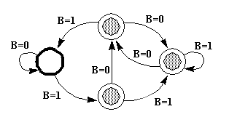
Exercise
Shown below in Figure, is a state transition diagram for an FSM, F, with a single binary input B.
The FSM has a single output, a light which is on for the three states marked by a gray dot.
The starting state is marked by the heavy circle.

Slide 58
To be continued… See you next week

